Slide 1
Race and International Human Rights: Historical Perspectives
Racial Equity and Human Rights Series
July 29, 2020

Slide 2
Dean Adrien Wing
UICHR Director; Associate Dean for International & Comparative law Programs; and Bessie Dutton Murray Professor of Law at the University of Iowa

Slide 3
1946 National Negro Congress 1947 NAACP 1951 Civil Rights Congress 1967 MLK Jr speech on Vietnam 1980 Free South Africa Movement 1996 National Black United Front 2014 Chicago activists

Slide 4
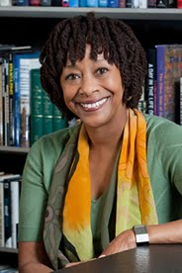
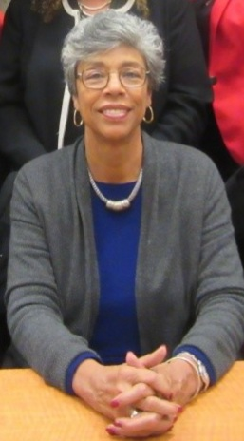
Heroes and She-roes
Professor Gay McDougall
Amb. Robert Van Lierop
Hon. Gabrielle Kirk McDonald

Slide 5
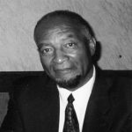
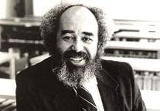
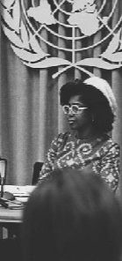
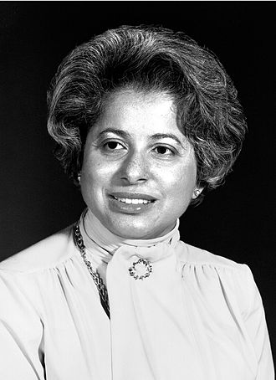
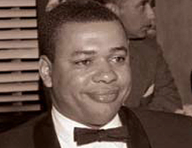
Dean Haywood Burns Professor YN Kly
Amb./Prof. Clyde Ferguson
Professor Goler Butcher
Amb./Dean Patricia Harris

